Slide 1
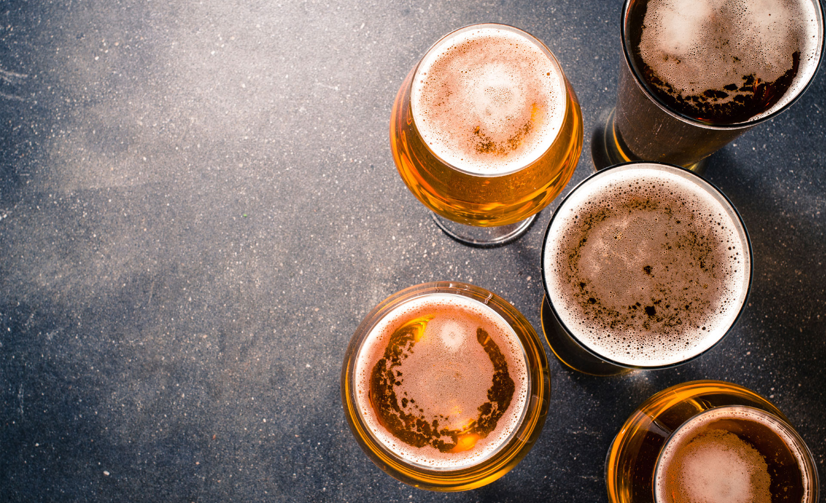

Predictive Pandas presents
Michelle Hocking
Eamonn McCallum
Pooja Mallard
Ruohong Yuan
Yann Chye
Kat Shamai

Slide 2


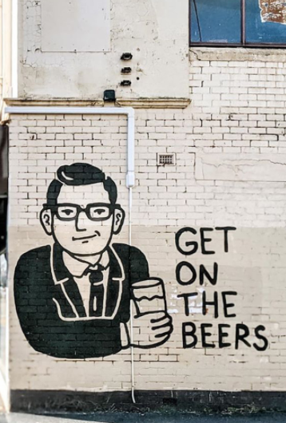
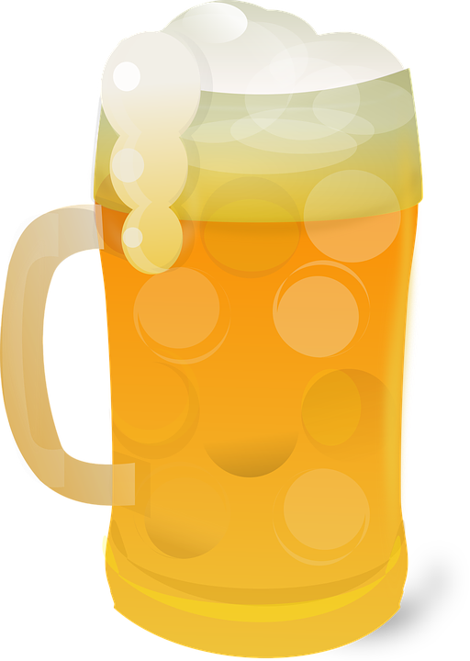
Now that Victorians can “get on the beers” again, what to drink?
You can go with the same old, same old but you’re probably tired of that since that’s all you’ve been drinking for the past 6 months
We thought it would be great to celebrate the world of craft beers and get beer lovers to try something different and find a new favorite
Using review data and data on breweries, we set out on a virtual brewery crawl to find good datasets and ways to teach a model how to appreciate craft beer, and recommend one
The oldest brewery dates back to 1040

Slide 3

Data points
From our search, we identified 3 data points which provided us with the information needed
Data point 1 – Dataworld
Data point 2 – BeerAdvocate Website
Data point 3 – Google API
The color of your beer has nothing to do with its alcohol content

Slide 4
Data Munging
Data extraction
Data transformation
Exploratory analysis
Visualising the data
Data aggregation
Adding features
Machine learning
Training the model
Web app
The Czech Republic consumed 2,033 million liters of beer in 2018

Slide 5
Data Extraction
The Pilsner’s name came from the Czech city of Pilsen (Plzeň)
DataWorld dataset
1.5m reviews
5,000 breweries
16,000 unique beers
13 data fields
2 identifiers each with a descriptor
5 review scores for different features
Time stamp and reviewer info

Slide 6
Data Exploration
Validated high alcohol content beers (outliers)
Investigate high correlation of review scores of 5 to identify bias
Inspect reviewers and timing of reviews for bias
Consider whether to reduce the reviews on scoring or other characteristics
Clean dataset enabled data profiling to start relatively quickly
Identify additional features for beers
Features were then separated into individual files to enable group work
Consolidated all updated feature files into one CSV dataset
Validation of data
The four main ingredients of beer are grain, hops, yeast, and water
Notes:
** Dataset relatively ‘clean’ so focus shifted quickly to data profiling
** Validated high alcohol content beers which appeared to be outliers initially
** Investigated high correlation in 5 review scores and discovered dataset skewed to the right - showing tendency to rate between 3-5
** Looked for bias in profilenames and timing of reviews
** Made decision to leave in/out reviews????
** As profiling evolved began to look for additional features to add in
** features created as individual files - as tasks split
** consolidated into a single csv

Slide 7
Data Finessing
Review the consolidated dataset
Applied aggregation to ratings
Remove beers with less than 2 reviews
Remove review scores of less than 3
Remove breweries with no location information or has closed
Consider Heroku constraints around number of records
Filtered dataset has 14k records
Explored ways to further reduce dataset
Elected to load static csv file to be hosted on Heroku
Filtered data
Other ingredients are called adjuncts
Notes:
** applied aggregation to ratings (mean?) and then filtered to remove less than 2 reviews and score less than 3, breweries with no location information or closed
** Consideration given to Heroke restraints - 10’000 records in a Postgres SQL db with ~14k records
** looked at increasing cutoff of reviews, randomising the dataframe and then reducing to 10’000 or loading a csv directly onto the server
** as csv file static elected to host on Heroku

Slide 8
More Data Finessing
Obtained lat and long, and address data from Google Maps for all breweries
Finessed beer styles to create new aggregator (from 104 to 11 styles)
Identify retired and seasonal beers in dataset
Removed retired beers as consumers won’t be able to access them
Sentiment analysis of reviews using “start words” from Beer Sommelier tasting guides
Barack Obama brewed his own beer at the White House
Notes:
** First stop (as always!) lat/lon - mapping feature - combination of Beer Advocate (source website) and google maps
** also ‘finessed’ the beer style values in the dataset, with a large number of ‘unique’ styles in the data, creating a new aggregator (from 104 to 11 styles)
** observed number of retired beers whilst working with the dataset. Field also included seasonal/annual availability so decided to add as a feature as well as quantify and decide whether to exclude
** words (sentiment analysis) - scraping reviewer sentiment including words (“start words”) rather than using stop words (used 173 in total) from beer sommelier tasting guides

Slide 9
Machine Learning
Performed initial regression analysis
PCA analysis wasn’t ‘fit for purpose’ but we tried!
Natural ‘fit’ was k-means or neural networks
Understanding the limitation of k-means
Frosty glasses cause foaming
Notes:
** initial regression analysis
** PCA analysis which wasn’t ‘fit for purpose’ but tried!
** natural ‘fit’ was K Means or neural network
** understanding limitation of KMeans ie arbitrary selection of cluster number looked at silhouette analysis

Slide 10
Training the model
Storing any kind of beer above 12° C will deteriorate its flavor and quality

Slide 11
Web App
Design
Customization for recommendations
Recommendations
Sketch of what the web app could look like
Design of look and feel using d3, Javascript, and HTML
Creation of NextBeer logo
A key feature of the web app is the ability to customize recommendation features
Use of sliders
Use of autocomplete for free text fields to limit variability of user input
Recommendations from machine learning model retrieved from Flask
Leaflet map visualization is populated with brewery information
Recommendations provided to users
Deployment to Heroku
Hops are poisonous to dogs.

Slide 12
Leaflet Visualisation
We wanted to add a map feature for users who want to visit the brewery or purchase the beers recommended
To create the map visualisation, we used Leaflet and the Google Map latitude and longitude data for each brewery
Information popup boxes were created to show users the brewery name and address information
A marker was created for each brewery (with a little beer stein of course!)
Most Americans live within 10 miles of a craft brewery

Slide 13
Interesting observations
Craft beer is more prized than commercial beer

Slide 14
Challenges
McDonald’s sells beer on its menu in many countries
Notes:
** finding the “right” features to improve predictability
** getting them once you find them - BIG data means lots of hours scraping and crunching data together
** translating the dataset into a concept and then sticking to it - losing site of what the model should do as the dataset evolves
** landing on a model type
** being able to ‘validate’ the accuracy (visualising, PCA and potentially silhouetting) - Eamonn to confirm

Slide 15
If I had my time again
‘Snake Venom’ is the strongest beer in the world with 67.5% alcohol by volume

Slide 16
Other features we would add
Seek feedback from users on our recommendation to enable further refinement of the machine learning model
Provide reviewing capabilities to grow the dataset for machine learning
Every year, the US generates profits of over 100 billion dollars from beer alone

Slide 17
Demo
Craft brewers currently provide an estimated 424,000 jobs in the U.S.

Slide 18
Any questions?
Beer drinkers are better thinkers at old age

